Slide 1






Introduction to Electronics

Slide 2
What is Electronics?
The term electronics is derived from the word “electrons”.
Electronics is a branch of Physics that deals with the theory and use of devices in which the electrons travel through a vacuum, gas, or a semiconductor medium.
The motion of electrons takes place under the influence of applied electric and magnetic fields.
Electronics is a vast field that is classified as:
Physical Electronics
Electronics Engineering

Slide 3
Physical electronics;
Helps to understand the motion of electrons in mediums like vacuum, gas, or semiconductor.
Electronics engineering;
Concentrates on the design, fabrication, and application of electronic devices. Electronics have developed rapidly from large circuits to small and powerful integrated circuits.

Slide 4
Inventions in Electronics;
Electronics have evolved around three components like vacuum tubes, transistors, and integrated circuits.
In 1883, the great Physicist Thomas Alva Edison found that electrons flow from one metal to another through a vacuum. This theory was known as the Edison Effect and it deals with conductors.
John Fleming in 1897 applied the Edison Effect to invent a two-element electron tube known as a diode.
Later in 1948, scientists Walter Brattain, John Bardeen, and William Shockley developed a device known as a transistor at Bell Laboratories. This invention was awarded the Nobel Prize.

Slide 5
Vacuum tubes were replaced by metal transistors since they offer longer life, low cost, efficiency, are light in weight, have less power consumption, and are smaller in size.
The concept of an integrated circuit was put forth in 1952 by Geoffrey.
Later in the 1960s, the full swing production of integrated circuits started.
Some of the devices that use integrated circuits are video cameras, microcomputers, medical equipment, and communication satellites.

Slide 6
Parts of Electronics Components
Transformer
Integrated circuits
Multimeter/ohmmeter
Capacitor
Resistor
Diode
Transistors
Light Emitting Diode

Slide 7
Transformer;
The transformer is basically a voltage control device that is used widely in the distribution and transmission of alternating current power.
It is commonly used to increase or decrease the supply voltage without a change in the frequency of AC between circuits.
The transformer works on the basic principles of electromagnetic induction and mutual induction.
In a step-up transformer, the output voltage is increased, and in a step-down transformer, the output voltage is decreased. The step-up transformer will decrease the output current, and the step-down transformer will increase the output current to keep the input and output power of the system equal.

Slide 8
Integrated circuits;
Integrated circuits are made up of several components such as capacitors, diodes and transistors.
They are built on a small single block or chip of a semiconductor known as an integrated circuit (IC).
All of them work together to perform a particular task.
Integrated circuits can function as an oscillator, amplifiers, microprocessors or even as computer memory.

Slide 9
Types of Integrated Circuits
ICs can be classified into different types based on their complexity and purpose. Some common types of ICs include:
1. Digital ICs:
These are used in devices such as computers and microprocessors. Digital ICs can be used for memory, storing data, or logic. They are economical and easy to design for low-frequency applications.
2. Analog ICs:
Analog ICs are designed to process continuous signals in which the signal magnitude varies from zero to full supply voltage. These ICs are used to process analog signals such as sound or light. In comparison to digital ICs, they are made of fewer transistors but are more difficult to design. Analog ICs can be used in a wide range of applications, including amplifiers, filters, oscillators, voltage regulators, and power management circuits.

Slide 10
3. Mixed-signal ICs:
Combining both digital and analog circuits, mixed-signal ICs are used in areas where both types of processing are required, such as screen, sensor, and communications applications in mobile phones, cars, and portable electronics.
4. Memory ICs:
These ICs are used store data both temporarily or permanently. Examples of memory ICs include random access memory (RAM) and read-only memory (ROM).
Memory ICs are among the largest ICs in terms of transistor count and require extremely high-capacity and fast simulation tools.

Slide 11
5.Multimeter:
A multimeter is a versatile electrical measuring instrument that is used to measure various functions, including voltage, current, and resistance.
It has a digital display and various settings to select the type of measurement you want to make.
With multimeter, you can troubleshoot electrical circuits, test components, and ensure everything is working properly.
6.Ohmmeter:
An ohmmeter is a specialized instrument used specifically for measuring resistance.
It helps you to determine the resistance of a component or a circuit by passing a small current through it.
Ohmmeters can be useful for identifying faulty components.

Slide 12
7.Capacitor;
A capacitor is a two-terminal electrical device that can store energy in the form of an electric charge. It consists of two electrical conductors that are separated by a distance.
The space between the conductors may be filled by vacuum or with an insulating material known as a dielectric. The ability of the capacitor to store charges is known as capacitance.
8.Resistor;
A passive electrical component with two terminals that are used for either limiting or regulating the flow of electric current in electrical circuits.
The main purpose of resistor is to reduce the current flow and to lower the voltage in any particular portion of the circuit. It is made of copper wires which are coiled around a ceramic rod and the outer part of the resistor is coated with an insulating paint.

Slide 13
9.Diode;
A diode is a two-terminal device that has the capacity to conduct electricity in only one direction. It acts like a one –way valve for electricity.
When voltage across a diode is in forward direction, it conducts current, but when the voltage is in reverse direction, it blocks the flow of current.
Diodes are used to protect circuits by limiting the voltage and to also transform AC into DC.
Semiconductors like silicon and germanium are used to make the most of the diodes.
There are different kinds of diodes and each type has its own applications.

Slide 14
10.Light Emitting Diode (LED);
When an electric current between the electrodes passes through this diode, light is produced. In other words, light is generated when a sufficient amount of forwarding current passes through it.
In many diodes, this light generated is not visible as there are frequency levels that do not allow visibility.
LEDs are available in different colors. There are tricolor LEDs that can emit three colors at a time. Light color depends on the energy gap of the semiconductor used.

Slide 15
Active and passive electronic components Electronic components are the building blocks of electronic circuits. They can be classified into two categories: Active and Passive components.
Active Components
Active components are those that require an external power source to operate. They are designed to amplify or switch signals, and are essential for the functioning of electronic circuits.
For Example: Transistors, Diodes, Integrated Circuits (ICs).
Passive Components
Passive components are those that do not require an external power source to operate. They are designed to provide a specific function in electronic circuits.
For Example: Resistors, Capacitors, Inductors.

Slide 16
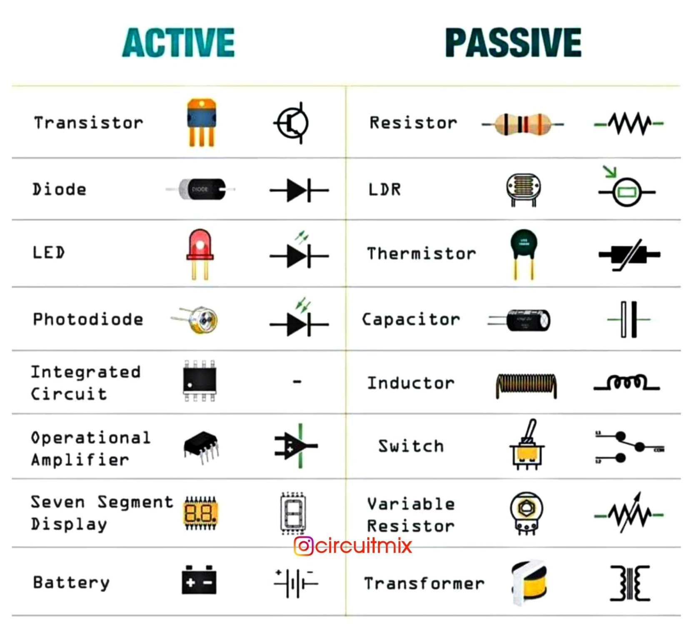

Slide 17
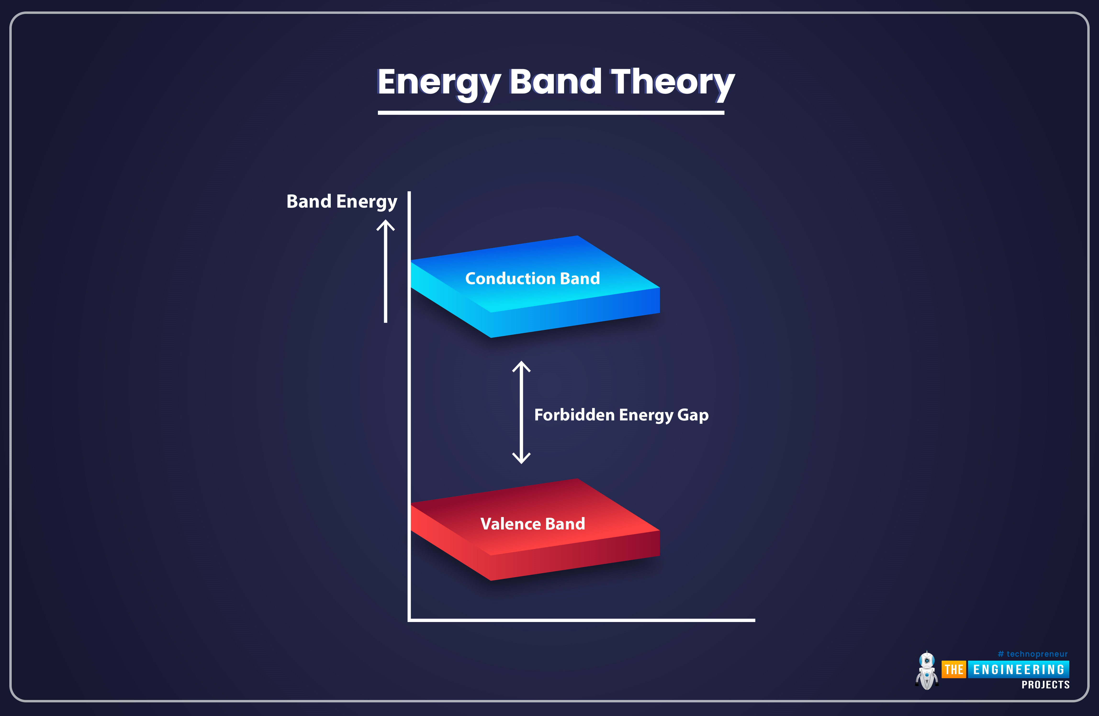
Energy Band Theory

Slide 18
In gaseous substances, the arrangement of molecules is spread apart and are not so close to each other.
In liquids, the molecules are closer to each other.
But, in solids, the molecules are closely arranged together, due to this atoms of molecules tend to move into the orbitals of neighboring atoms.
Hence, the electron orbitals overlap when atoms come together.
In solids, several bands of energy levels are formed due to the intermixing of atoms in solids. We call these set of energy levels as energy bands.

Slide 19
Formation of Energy Bands
In an isolated atom, the electrons in each orbit possess definite energy. But, in the case of solids, the energy level of the outermost orbit electrons is affected by the neighboring atoms.
When two isolated charges are brought close to each other, the electrons in the outermost orbit experience an attractive force from the nearest or neighboring atomic nucleus. Due to this reason, the energies of the electrons will not be at the same level, the energy levels of electrons are changed to a value which is higher or lower than that of the original energy level of the electron.
The electrons in the same orbit exhibit different energy levels. The grouping of these different energy levels is known as the energy band.

Slide 20
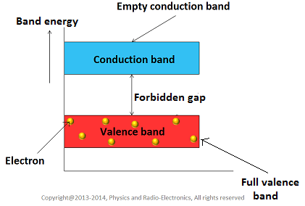
Classification of Energy Bands

Slide 21
1. Valence Band
The electrons in the outermost shell are known as valence electrons. These valence electrons contain a series of energy levels and form an energy band known as the valence band.
The valence band has the highest occupied energy.
The valence band is the band of electron orbitals that electrons can jump out of, moving into the conduction band when excited.
The band above the valance band is conduction band.

Slide 22
A lot of energy is required to excite valence electrons to the conduction band.
It plays a vital role in determining the electrical and optical properties of materials. The electrons in the valence band are tightly bound to their respective atoms and are not free to move around.
The large energy gap between the valence band and the conduction band acts as a barrier for electron movement, making insulators poor conductors of electricity.

Slide 23
2. Conduction Band
The conduction band is another important concept in solid-state physics. It is the energy band in a material where electrons can move freely and contribute to electrical conductivity.
The free electrons conduct current in conductors and are therefore known as conduction electrons.
Unlike the valence band, which is fully occupied by electrons, the conduction band is partially or completely empty at absolute zero temperature.

Slide 24
When energy is supplied to a material, such as through heat or an applied electric field, electrons can be excited from the valence band to the conduction band. In the conduction band, these electrons are free to move and conduct electricity.
Materials with a partially filled conduction band, like metals, tend to have high electrical conductivity.
The behavior of the conduction band, along with the valence band, plays a important role in determining the electrical and optical properties of materials.

Slide 25
3. Forbidden Energy Gap
The gap between the valence band and the conduction band is referred to as the forbidden gap.
It represents the energy difference that electrons need to overcome in order to transition from the valence band to the conduction band.
As the name suggests, the forbidden gap doesn’t have any energy and no electrons stay in this band.
If the forbidden energy gap is greater, then the valence band electrons are tightly bound or firmly attached to the nucleus. We require some amount of external energy that is equal to the forbidden energy gap.

Slide 26
The size of the band gap determines the electrical and optical properties of a material.
If the band gap is large, the material is more likely to be an insulator or a semiconductor.
If the band gap is small or non-existent, the material is more likely to be a conductor.

Slide 27
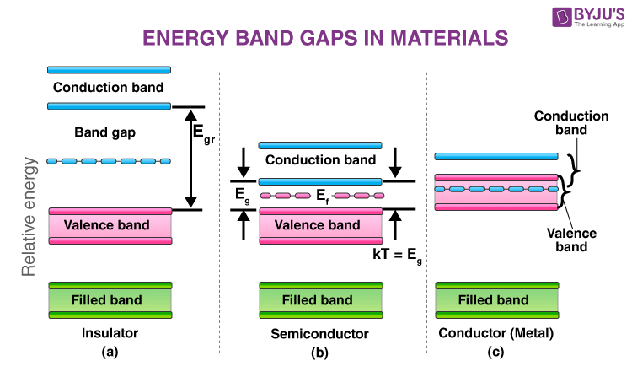

Slide 28
Conductors
Gold, Aluminum, Silver, Copper, all these metals allow an electric current to flow through them.
There is no forbidden gap between the valence band and conduction band which results in the overlapping of both the bands. The number of free electrons available at room temperature is large.
Conductivity is a factor used to measure the flow of electrons in any given material. Copper has a very high conductivity of 5.95 x 107 W-1m-1, thereby allowing electricity to flow more freely than aluminum.
Aluminum has a slightly lower conductivity of 3.77 x 107 W-1m-1 when compared to copper.

Slide 29
Semiconductors
Germanium and Silicon are the most preferable material whose electrical properties lie in between semiconductors and insulators.
They have a moderate band gap, which means that electrons need a certain amount of energy to move from the valence band to the conduction band.
One cool thing about semiconductors is that their conductivity can be controlled. By introducing impurities or applying external influences, we can manipulate their electrical properties. This makes semiconductors extremely useful in electronic devices like transistors, diodes, and integrated circuits.

Slide 30
For Germanium, the forbidden gap is 0.72eV and for Silicon, it is 1.1eV. Thus, semiconductor requires small conductivity.
Silicon is one of the most commonly used semiconductors. It's found in many electronic devices due to its abundance and favorable electrical properties. Semiconductors have revolutionized technology and are the backbone of modern electronics.

Slide 31
Insulators
Glass and wood are examples of the insulator.
These substances do not allow electricity to pass through them.
They have high resistivity and very low conductivity.
The energy gap in the insulator is very high up to 7eV.
The material cannot conduct because the movement of the electrons from the valence band to the conduction band is not possible.

Slide 32
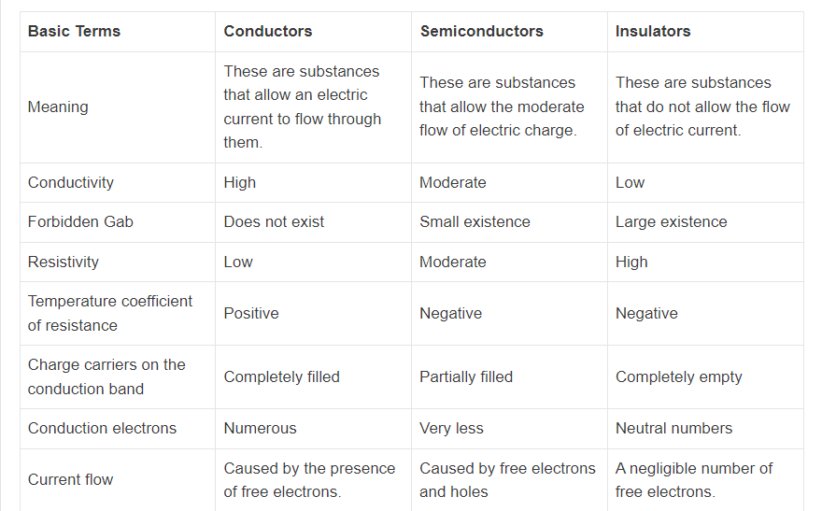
Comparison Table (Conductors vs Semiconductors vs Insulators)

Slide 33
